Slide 1
EE451: High Voltage Engineering
Lecture 10

Slide 2
Outline
Breakdown Mechanism in Gases
Introduction
Air as insulating medium
Ionization by collision
Photo-ionization
Secondary ionization processes
Page 2

Slide 3



Introduction
The suitability of application of gaseous dielectrics in high voltage apparatus depends upon their physical, chemical, and electrical properties.
The gases used as dielectrics are classified into two main groups:
Electro-positive gas (tendency to give up electrons forming positive ions)
Electro-negative gas (capable of absorbing free electrons forming negative ions)
The most widely used gaseous dielectrics:
Atmospheric air
Pure nitrogen (N₂), that is, an electropositive gaseous dielectric
sulphurhexaﬂuoride (SF₆ ), that is, an electronegative gases
Page 3

Slide 4


Introduction
There are many other gases which have found use but to a limited extent in high voltage insulation techniques. For example:
Oxygen (O₂)
Hydrogen (H₂)
Carbon dioxide (CO₂)
Helium (He)
Neon (Ne)
Carbon tetrachloride (CCl₄)
Sodium vapour (Na) diﬂuorodichloro methane (CCl₂F₂), also known as Freon etc.
Page 4

Slide 5
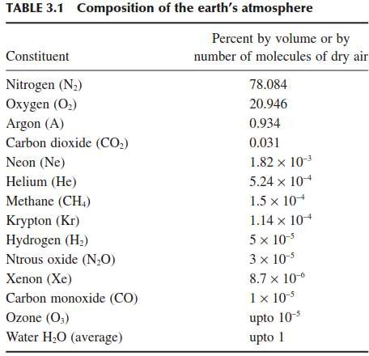




Air as an Insulating Medium
However, air is the most important, freely available, and cheapest gaseous dielectric.
The atmospheric air is in fact a mixture of a number of gases.
Nitrogen is an electropositive gas whereas oxygen is an electronegative gas.
Page 5

Slide 6
Air as an Insulating Medium
The largest percentage content of atmospheric air is nitrogen (about 78%), which is an electropositive gas.
The second largest constituent is oxygen (about 20%), which is a very weak electronegative gas.
The content of hydrogen, an electronegative gas too, is so low (5 × 10⁻⁵ %) that for all practical purposes the air can be considered as an electropositive gas.
Much theoretical as well as experimental research work, available in literature, has been performed on air to study the complicated discharge processes in gaseous dielectrics.
That is why scientists have chosen air to develop a “model of discharge” or more appropriately termed as “breakdown mechanisms ” for gaseous dielectrics.
Page 6

Slide 7



Ionization Processes
At normal temperature and pressure, the gases are excellent insulators. However, when a high voltage is applied between the two electrodes immersed in a gaseous medium, the gas becomes a conductor and an electrical breakdown occurs.
The process of build-up of high currents in a breakdown, in which electrons and ions are created from neutral atoms or moelcules, and their migration to the anode and cathode respectively leads to high current is called ionization.
The processes that are primarily responsible for the breakdown of a gas are:
Primary ionization processes.
Secondary ionization processes
In insulating gases (also called electron-attaching gases), the process of attachment also plays an important role.
Page 7

Slide 8

Primary Ionization Processes
The primary ionization processes are further classified as:
Ionization by collision
Photo-ionization
Ionization by metastable atoms
Thermal ionization
Page 8

Slide 9
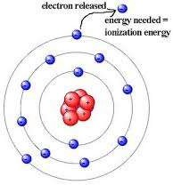




Ionization by Collision
The process of liberating an electron from a gas molecule with the simultaneous production of a positive ion is called ionization.
In the process of ionisation by collision, a free electron collides with a neutral gas molecule and gives rise to a new electron and a positive ion.
Page 9

Slide 10



Ionization by Collision
Under applied field, any electron starting at the cathode will be accelerated more and more between collisions with other gas molecules during its travel towards the anode.
If the energy (ε) gained during this travel between collisions exceeds the ionisation potential, V_{i}, which is the energy required to dislodge an electron from its atomic shell, then ionisation takes place. This process can be represented as:
where, A is the atom, A⁺ is the positive ion and e⁻ is the electron.
A few of the electrons produced at the cathode by some external means, say by ultra-violet light falling on the cathode, ionise neutral gas particles producing positive ions and additional electrons.
Page 10

Slide 11
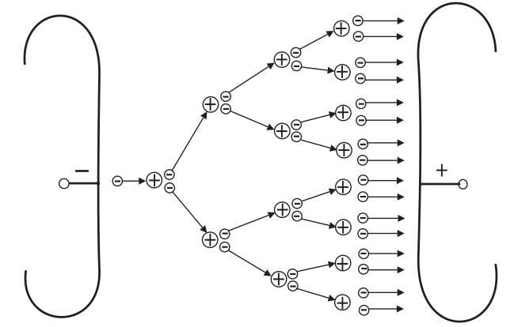


Ionization by Collision
The additional electrons, then, themselves make 'ionising collisions' and thus the process repeats itself.
This represents an increase in the electron current, since the number of electrons reaching the anode per unit time is greater than those liberated at the cathode.
In addition, the positive ions also reach the cathode and on bombardment on the cathode give rise to secondary electrons.

Slide 12








Photo-ionization
The ionization by radiation or photons involves the interaction of radiation with matter.
Photo-ionization occurs when the amount of radiation energy absorbed by an atom or molecule exceeds its ionisation potential and is represented as:
where A and B represent a neutral atom or molecule in the gas and hν the photon energy.
Photo-ionization is a secondary ionization process and is essential in the streamer breakdown mechanism and in some corona discharges.

Slide 13





Ionization by Metastable
The life time of certain elements in some of the excited electronic states extends to seconds (10 ⁻³ s) compared to the lifetime of an ordinary particle (10 ⁻⁸ s). These are known as metastable states and these atoms are known as metastables.
Metastables have a relatively high potential energy and are, therefore, able to ionize neutral particles.
Let A be the atom to be ionized and B^{m} the metastable, when B^{m} collides with A, ionization may take place according to the reaction:
Ionization by metastable interactions comes into operation long after excitation.

Slide 14
Thermal Ionization
When a gas is heated to high temperature (to the order of 10,000 K and above), some of the gas molecules acquire high kinetic energy and these particles after collision with neutral particles ionize them and release electrons.
These electrons and other high-velocity molecules in turn collide with other particles and release more electrons. Thus, the gas gets ionized.
Thermal ionization is the principal source of ionization in arcs and flames.

Slide 15


Secondary Ionization Processes
Secondary ionisation processes by which secondary electrons are produced are the one which sustain a discharge after it is established due to ionisation by collision, photo-ionization and thermal ionization.
Cathode plays an important role in gas discharges by supplying electrons for the initiation, sustainance and completion of a discharge.
In a metal, under normal condition, electrons are not allowed to leave the surface as they are tied together due to the electrostatic force between the electrons and the ions in the lattice.
The energy required to knock out an electron from a Fermi level is known as the work function and is a characteristic of a given material.

Slide 16

Secondary Ionization Processes
There are various ways in which this energy can be supplied to release the electron:
Electron emission due to positive ion
Electron emission due to excited atom bombardment and photons
Thermionic emission
Field emission

Slide 17





Electron Emission due to Positive Ion
Positive ions are formed due to ionisation by collision or by photo-ionisation, and
being positively charged, they travel towards the cathode.
A positive ion approaching a metallic cathode can cause emission of electrons from the cathode by giving up its kinetic energy on impact.
If the total energy of the positive ion, namely, the sum of its kinetic energy and the ionisation energy, is greater than twice the work function of the metal, then one electron will be ejected and a second electron will neutralise the ion.
The electron emission by positive ion is the principal secondary process in the Townsend spark discharge mechanism

Slide 18
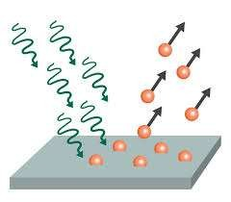
Electron Emission due to Excited Atom Bombardment and Photons
Neutral excited atoms or molecules (metastables) incident upon the cathode surface
are also capable of releasing electron from the surface.
To cause an electron to escape from a metal, it should be given enough energy to overcome the surface potential barrier.
The energy can also be supplied in the form of a photon of ultraviolet light of suitable frequency.
Electron emission from a metal surface occurs at the critical condition:
where φ is the work function of the metallic electrode.

Slide 19
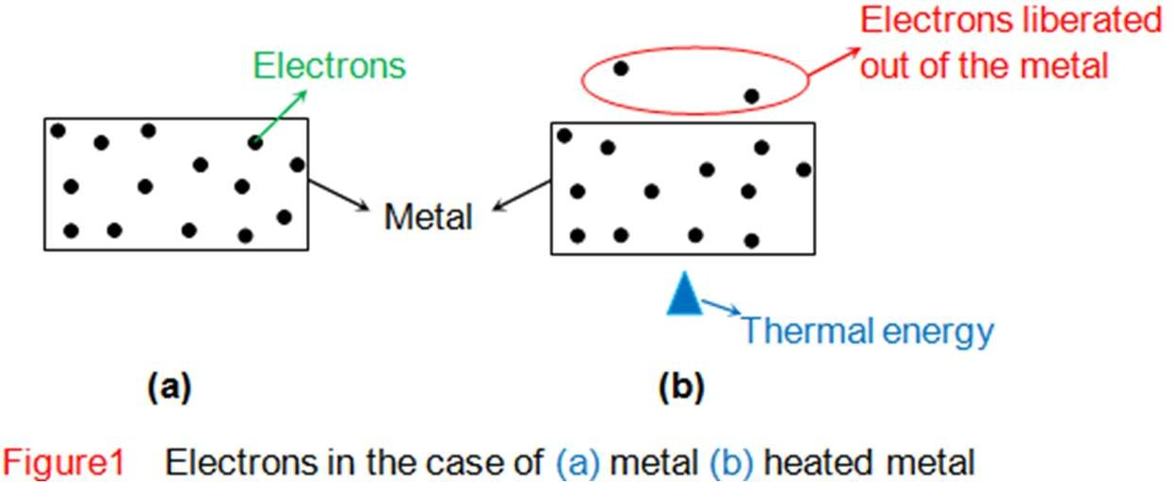

Thermionic Emission
At room temperature, the conduction electrons of the metal do not have sufficient thermal energy to leave the surface.
However, if the metals are heated to temperature 1500°K and above, the electrons will receive energy from the violent thermal lattice in vibration sufficient to cross the surface barrier and leave the metal.
Normally metals with low work function are used as cathode for thermionic emission.

Slide 20
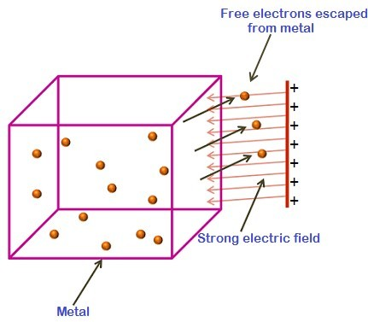

Field Emission
If a strong electric field is applied between the electrodes, the effective work function of the cathode decreases.
This is known as Schottky effect and holds good over a wide range of temperature and electric fields.
Calculations have shown that at room temperature the total emission is still low even when fields of the order of 10⁵ V/cm are applied.
However, if the field is of the order of 10⁷ V/cm, the emission current has been observed to be much larger than the calculated thermionic value
Page 20

Slide 21
THANK YOU FOR YOUR ATTENTION

